Slide 1

Superstore Sales
Team 3

Slide 2

TEAM MEMBERS
AHMED IBRAHIM
AHMED ALY HASSAN
SHAIMAA ABD ELRAHEEM
HODA GOMAA
ASHRAKT SAYED
AHMED MELEGY
ABD ELRAHMAN MOHAMED

Slide 3
Table of Content
Introduction
Project Overview
Data Set
Cleaning Stage Of Our data
Data Modeling
DAX In The Project
Report Of Our Data
Insights From Dataset
Q & A

Slide 4
Introduction
This project is part of the graduation requirements for the Microsoft Power BI Engineer track under the Egyptian Ministry of Communications and Information Technology’s Digital Egypt Pioneers initiative.
The goal of the project is to apply the skills acquired during the training to analyze real-world sales data using Power BI tools.
The dataset consists of a detailed Excel file containing sales information, including order details, customer profiles, product data, financial performance, and sales metrics.
The aim is to transform this data into interactive dashboards that support data-driven decisions and operational efficiency.

Slide 5
Data Overview
The project is based on an Excel file containing sales data from the United States. The dataset includes various columns covering the following areas:
Order Details: Order ID, Order Date, Ship Date, Order Status
Customer Information: Name, Segment, City, State, Zip Code, Country, Gender, Marital Status
Product Details: Category, Sub-category, Product Name, Quantity
Geographic Info: City, State, Region
Financial Metrics: Sales, Discount, Profit, Tax, Freight, Subtotal
Payment Mode and Sales Person
This data was modeled and analyzed using Power BI to generate insights and build a comprehensive dashboard.

Slide 6
Data Cleaning
We encountered several challenges when working with the raw dataset, and a number of issues needed to be addressed before starting the analysis:
Identified Issues:
Missing values in fields like profit and discount.
Inconsistent formatting, especially in date fields.
Duplicate rows that needed removal.
Text inconsistencies (e.g., variations in product or payment names).
Presence of unnecessary columns that were removed for clarity.
Tools Used for Cleaning:
Excel: Used for removing duplicates, formatting, and minor value corrections.
Power Query in Power BI: Used for filtering, transforming data types, and standardizing formats.
After cleaning, the data became:
Well-structured and consistently formatted for easy table relationships.
Free of critical duplicates and missing data.
Ready for data modeling and effective analysis.

Slide 7
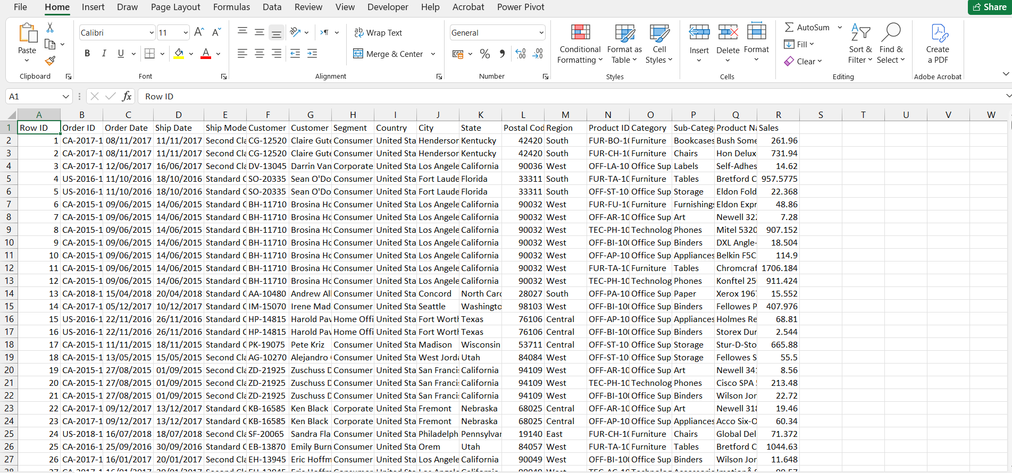
Data Set Before

Slide 8
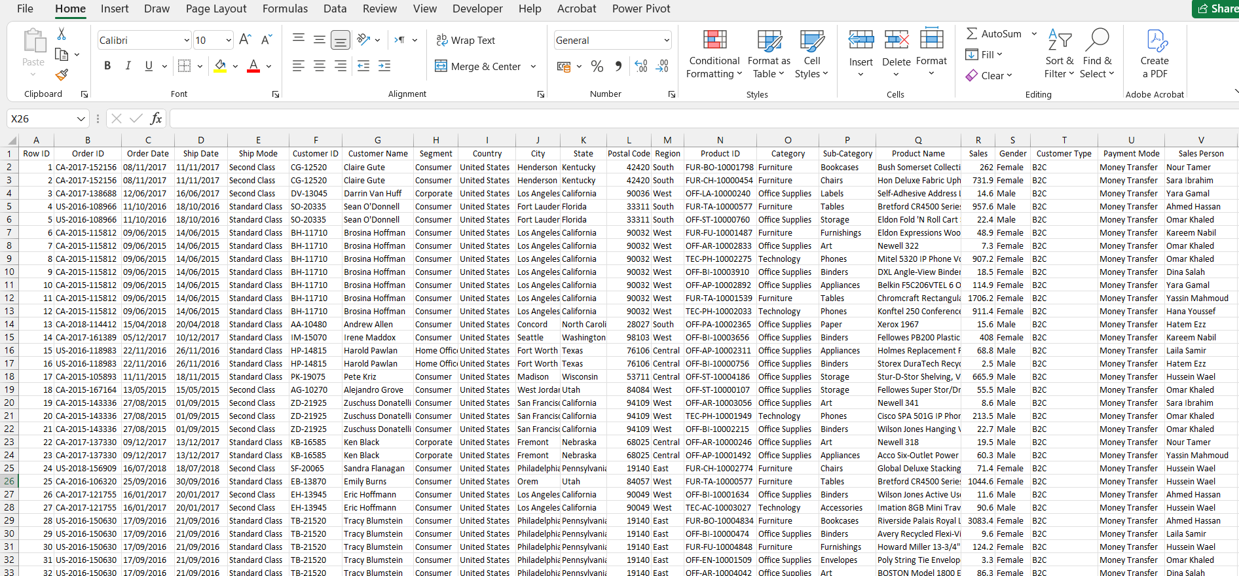
Data Set After

Slide 9
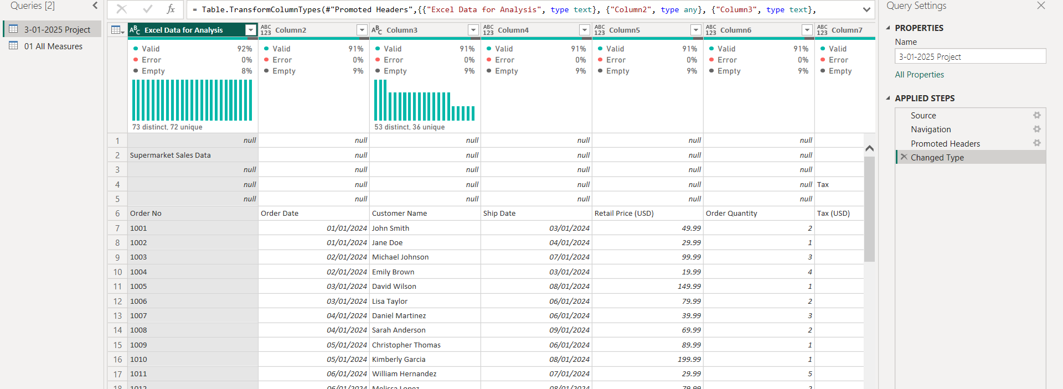
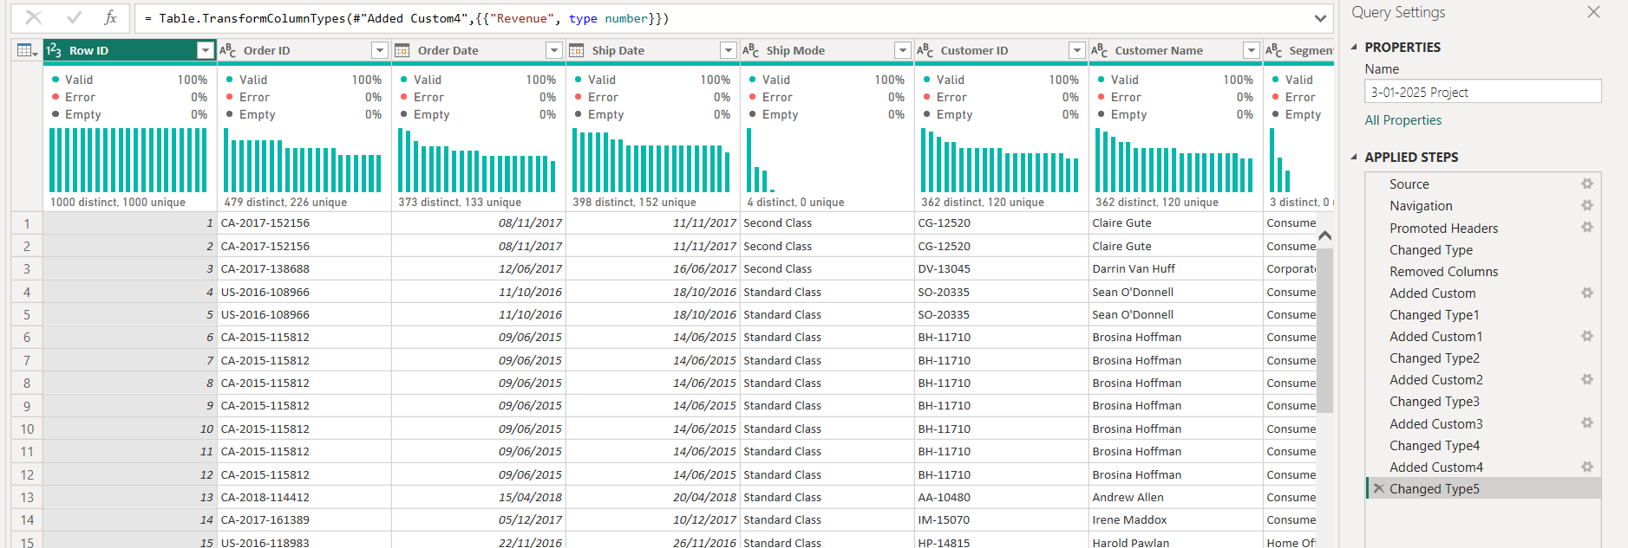
BEFORE
AFTER

Slide 10
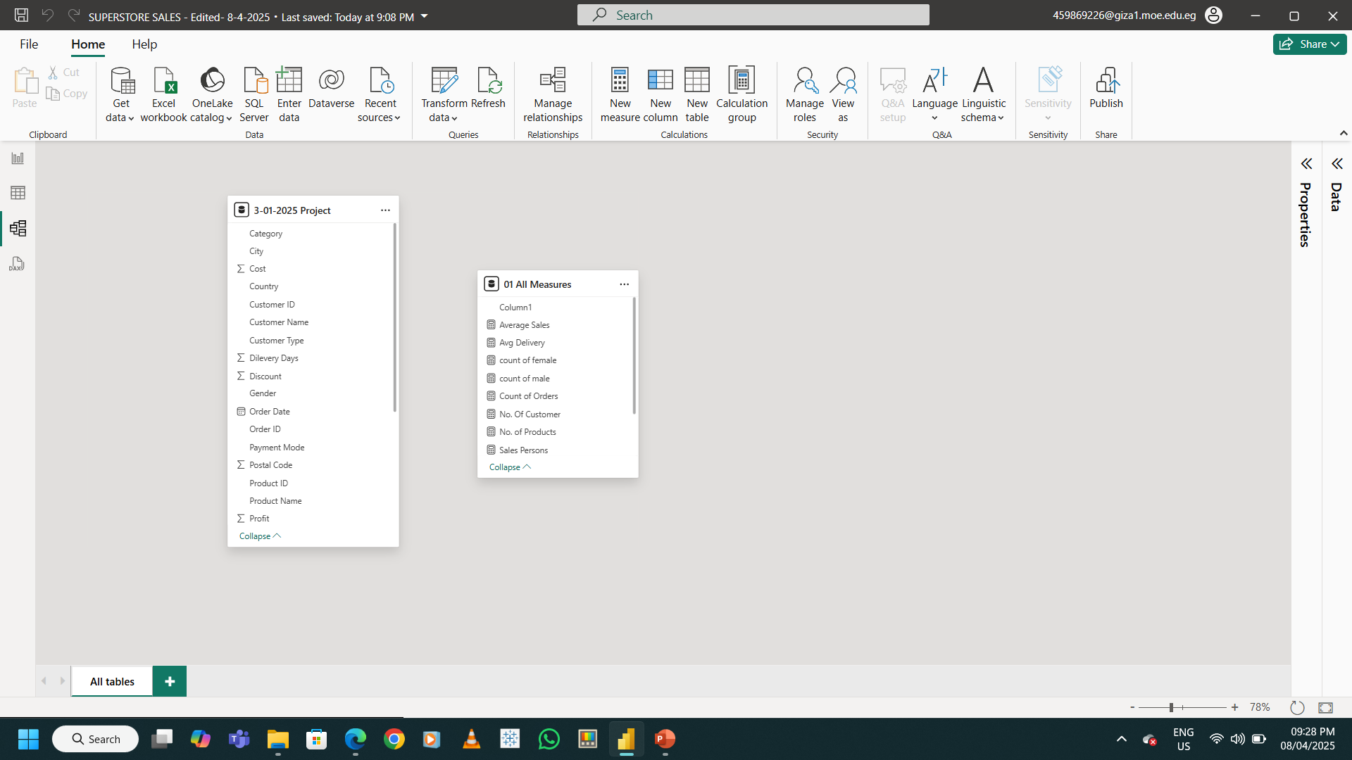
Data Modeling

Slide 11
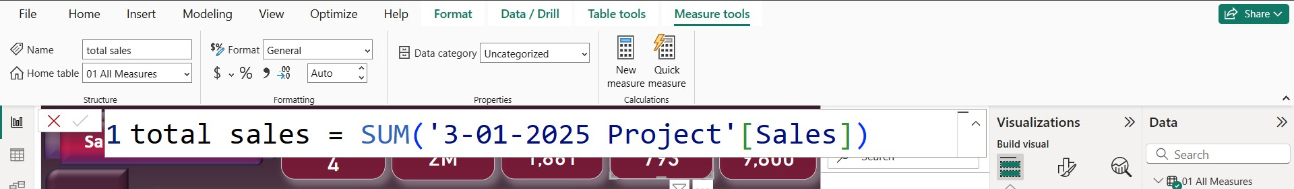
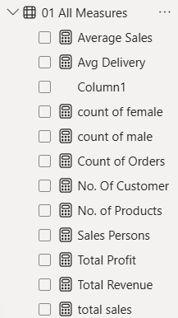
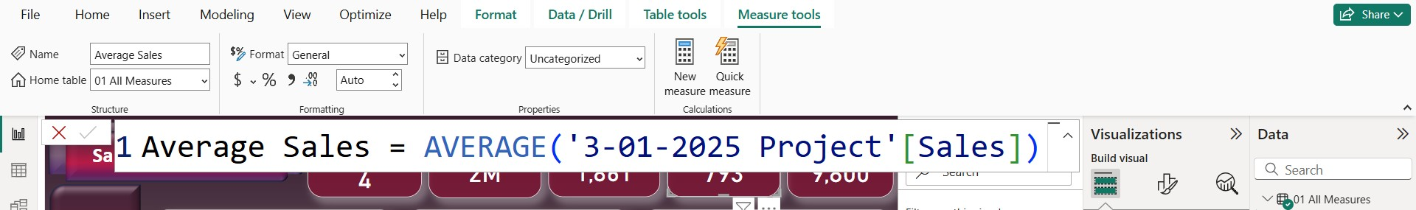
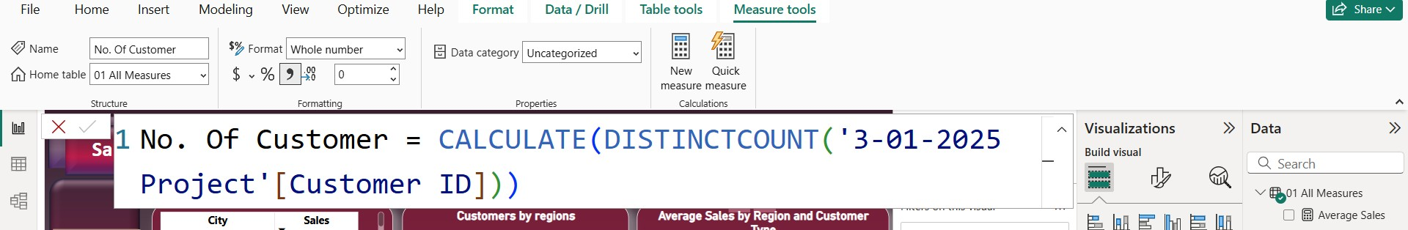
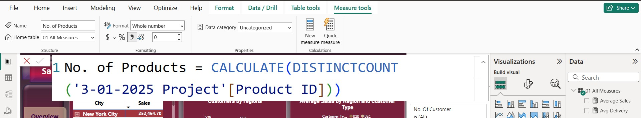
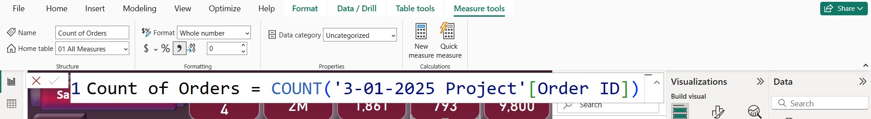
DAX’s Measures
We used DAX (Data Analysis Expressions) to create several measures that helped us extract valuable analytical insights.
These measures were used in KPIs and visual reports to analyze performance by product, region, and category.
Total Sales :
Average Sales:
No. Of Customers:
No. Of Products:
Count of Orders:

Slide 12

Dashboard Design
“In designing the dashboard, we followed three key principles:
Simplicity:
We structured each page clearly and logically. Each tab focuses on a specific area: an overview, sales details, product performance, and sales reps' KPIs.
Color Scheme:
We used shades of red and burgundy for visual appeal and to highlight key elements. For the data visuals themselves, we used gold and beige tones to ensure readability and soft contrast.
Visual Hierarchy:
We placed key KPIs at the top of the page – like total customers, orders, and sales volume – followed by charts and detailed visuals in the middle and right, with navigation buttons on the left.
Here are some examples:
On the Overview page, we included high-level insights like top-performing cities, quarterly sales, and breakdowns by sector and category.
The Sales Details page shows customer names, sales by region, and customer types – allowing for more targeted analysis.”

Slide 13
Interactivity & Filters
“We added multiple interactive features to make the dashboard dynamic and user-friendly:
Slicers:
Users can filter by month, subcategory, and sector with a single click – and all visuals adjust instantly.
Drill-through:
By clicking on a specific data point – like a city or product – users are taken to a detailed page showing more granular information.
Custom Tooltips:
When hovering over a chart (for example, on the map), a tooltip appears with extra context – allowing users to get more insights without cluttering the layout.”
“Navigation between pages is done using the left-hand tab panel, and users can explore the reports in real time – which makes data analysis faster, smoother, and more intuitive.”

Slide 14
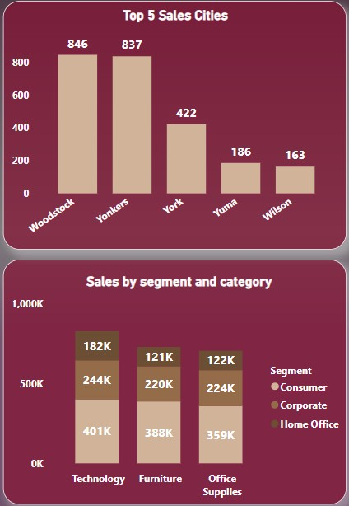
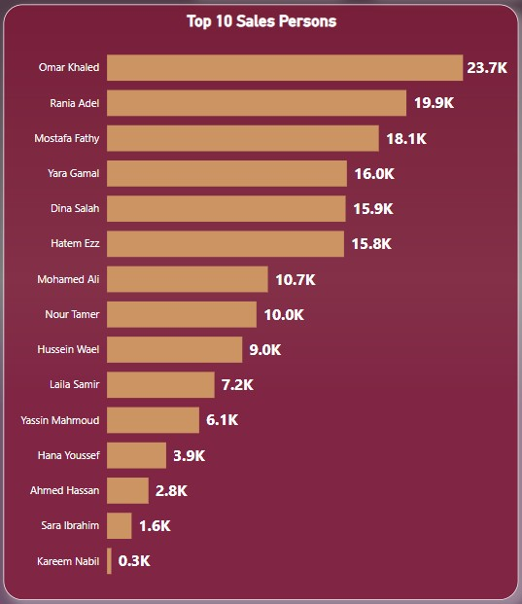
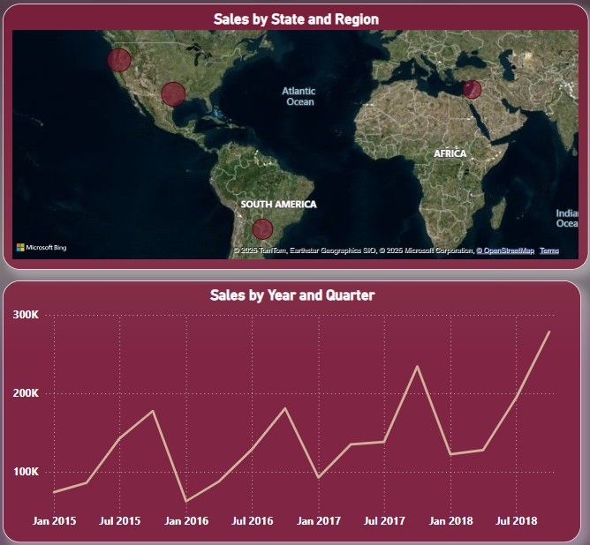
Visuals, Charts, and Graphs

Slide 15
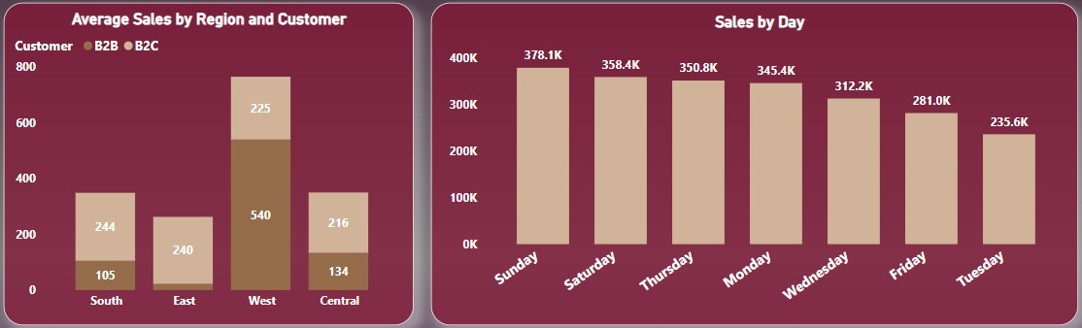
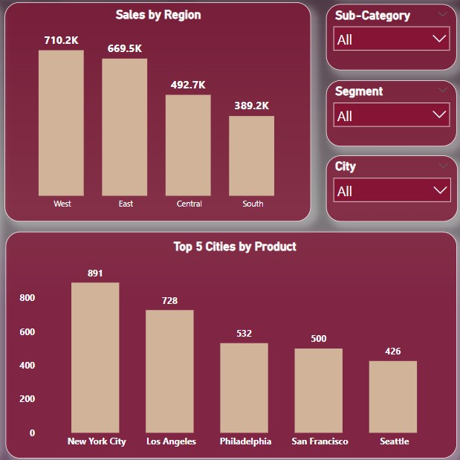
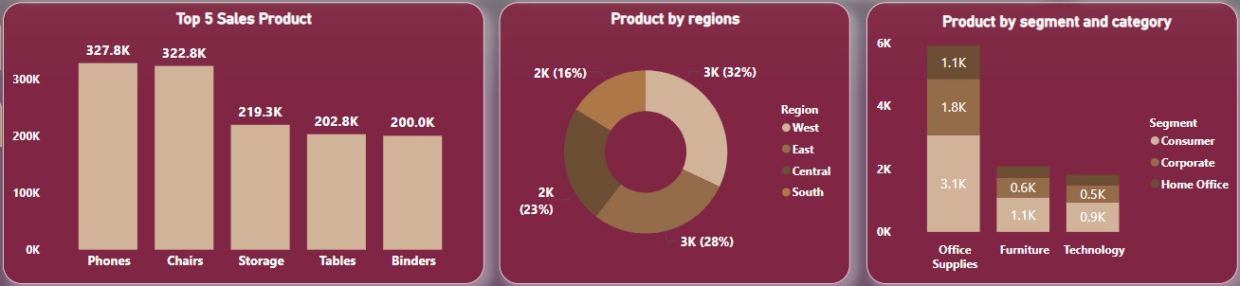
Charts and Graphs

Slide 16

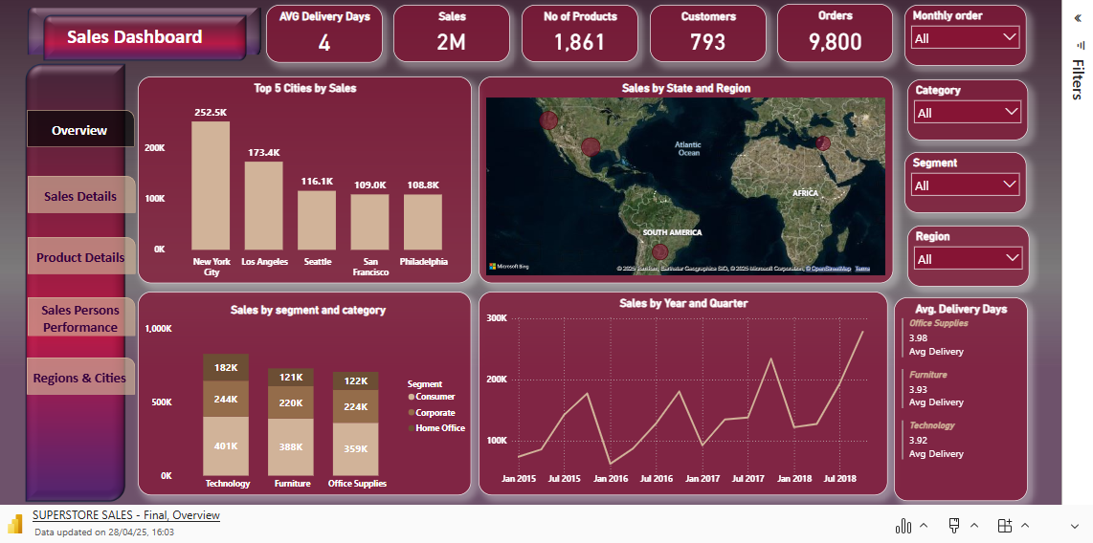
Microsoft Power BI

Slide 17
Insights
After analyzing the data using our dashboard, we uncovered several important insights that can guide strategic decisions:
Top-Performing Products:
Certain products – like [Canaon printers] and [Electric Punch] – consistently generated the highest sales across most sectors and regions.
Weak & Strong Branch Performance:
Some branches – particularly in [New York City] and [Los Angeles] – recorded significantly higher sales and more orders.
Some branches – particularly in [Elyria] and [Abilene] – had noticeably lower sales and fewer orders, even in high-demand periods.
Customer Type Impact:
B2C customers represented a larger volume of orders, higher revenue per transaction, but the B2B segment showed lower volume of orders and revenue - a key point for revenue strategy.
Seasonality Trends:
We observed strong sales spikes in [Q3 and Q4], while [Q1] showed a noticeable dip, Q3 sales are boosted by back-to-school shopping, while Q4 benefits from holiday spending like Black Friday and Christmas. In contrast, Q1 sees a dip due to post-holiday fatigue and slower consumer activity.

Slide 18
Insights
Technology leads 37% of total sales driven by high-demand in products like phones and Machines,
Furnitures leads 32% of total sales driven by high-demand in products like Chairs and Tables,
Office Supplies leads 31% of total sales driven by high-demand in products like Storage and Binders.
The West Region contributes about 31 % of total sales, while it contributes about 81% from B2B sales across all regions.
The South Region contributes about 17 % of total sales, while it contributes about 9% from B2B sales across all regions
Q4 Saw a notable growth each year its 8 % at 2015, 8% at 2016, 10% 2017, and 12% at 2018 of total Sales.
The Average Delivery days are 4 days.
These insights enabled us to move beyond simply reporting numbers, towards understanding the drivers of performance, and identifying opportunities and risks.

Slide 19
Recommendations
Based on our findings, we suggest the following actions to improve overall performance:
Focus on High-Performing Products:
Increase marketing and stock levels for the top-selling products to maximize their momentum.
Branch-Specific Support:
Launch performance improvement plans for underperforming branches, including staff training and local marketing campaigns.
Targeted Customer Strategy:
Design separate strategies for B2B and B2C customers – with personalized offers, pricing, and loyalty programs to boost both volume and value.
Plan Around Seasonality:
Use seasonal sales trends to guide promotional calendars, inventory planning, and budget allocations.
Explore Underperforming Regions:
Investigate why some regions underperform despite market potential – and consider new partnerships, promotions, or even restructuring branch responsibilities.”
Optimize Peak Sales Days:
Increasing the number of sales staff to reduce wait times and improve service quality.
Extending working hours to accommodate higher customer traffic.
Boosting inventory levels in advance to avoid stockouts.
Ensuring systems and staff are fully prepared to handle increased transaction volume efficiently.

Slide 20
Lessons Learned
Despite the challenges, this project was a great learning experience for all of us – both technically and personally:
Technical Skills:
Advanced Power BI usage: data modeling, measures, slicers.
Writing and optimizing DAX.
Improving our data visualization and storytelling skills.
Soft Skills:
Teamwork & collaboration: We learned how to divide tasks, help each other, and stay aligned.
Problem-solving: Each obstacle helped us grow faster and find creative solutions.
Time management:
Working on a deadline taught us to prioritize and stay focused.
We now feel more confident handling data projects from start to finish – not just in tools, but in mindset and teamwork.

Slide 21


Slide 22

We’d like to thank the committee, trainers, and everyone who supported us throughout this journey
Thanks again and we hope you enjoyed the presentation as much as we enjoyed building it!

